Slide 1
An Update on HPV Testing in BC
W Kim MacDonald
slides courtesy of David Quinlan,
Victoria, BC

Slide 2
Disclosures
No conflict of interest
No off-label recommendations

Slide 3
OBJECTIVES:
Understand the role of HPV in Cervical Cancer
Protocol for HPV self testing
Protocol for HPV provider testing

Slide 5
Prevention – Vaccination and Screening
Cervical cancer is almost entirely preventable through:
Primary Prevention (Vaccination)
HPV vaccination is ideally given to people before they become sexually active and are exposed to HPV
HPVV offers the best immune response when given to those under the age of 15, but still effective if given later
Recommended post treatment for cervical dysplasia to prevent recurrence
It’s never too late to receive the vaccine
genital warts essentially eliminated in Australia
Secondary Prevention (Screening)
Detecting and treating pre-cancer before it becomes invasive
Notes:
GINA

Slide 6
Prevention - Vaccination
Individuals 9 to 20 years of age, unless immunocompromised, should receive one dose of 9vHPV vaccine. A 2-dose schedule may be considered on an individual basis for individuals 9 to 20 years of age with shared decision-making with their healthcare provider.
Individuals 21 to 26 years of age, unless immunocompromised, should receive 2 doses of 9vHPV vaccine at least 24 weeks apart (6 months).
Individuals 27 years of age and older, unless immunocompromised, may receive a 2-dose schedule of 9vHPV administered at least 24 weeks apart (6 months).
When recommended to receive HPV vaccine, individuals who are considered immunocompromised and/or living with HIV should receive a 3-dose schedule of 9vHPV vaccine (months 0, 2, and 6).
Individuals who have received a different HPV vaccine may consider an additional dose of the 9vHPV vaccine for added protection against additional HPV types, following a discussion with their healthcare provider.
Although 2vHPV vaccine continues to be authorized in Canada, 9vHPV vaccine should be used due to its protection against a greater number of HPV types and associated diseases.
As syncope post-vaccination is common in younger people, vaccine recipients should be observed for 15 minutes after vaccine administration.
Health Canada 2025
Notes:
GINA
3 dose in colpo
any age
$150 per shot?

Slide 7
Prevention - Screening

Slide 10
HPV self-testing
HPV testing offers innovative approaches for screening beyond clinician/clinic-based care (to increase reach and coverage)
Provides opportunities to decrease barriers when face-to-face care not feasible
HPV testing on self-collected samples provides similar results to provider collected samples (Arbyn et al. BMJ 2018)
Highly acceptable (Australia and Netherlands currently offering self-collection in their national programs)
Notes:
avoid self tests in the office

Slide 11
Who is eligible for self-testing?
Anyone in B.C. aged 25 to 69 who:
Has a cervix
Is due for screening
Has ever had sexual contact
Has not been recommended for a cotest as their next screen
Not pregnant
No pessary
No AIS ever
Is registered with the Medical Services Plan.

Slide 12
Who would require a provider collected sample?
Will undergo a speculum exam anyway
Taking an LBC specimen may prevent the patient from needing another in-person
visit if their self-screening test is positive
Patient does not regularly interact with the health system
Has a disability, mobility challenge or a body habitus that makes self-screening difficult
Requires a cotest (HPV and cytology testing) for screening

Slide 14
Colposcopy clinic will see patients for:
Follow-up and management of abnormal screening results
Surveillance of higher than average risk patients
Clinical abnormalities identified by primary care provider
Benchmark for HPV16, 18 self test – 8 weeks.

Slide 15
SCREENING AFTER HYSTERECTOMY
Total hysterectomy (i.e. cervix removed and with no past or present high-grade cervical abnormality (i.e. CIN 2, CIN 3, AIS or cervical carcinoma) can discontinue screening.
Total hysterectomy with previous CIN 2, CIN 3 or AIS diagnosis should have a cotest from the vaginal vault at 12 months post hysterectomy. If HPV is negative and cytology is NILM, LSIL or ASCUS they can discontinue screening.
If at the 12 month cotest, HPV is positive or if cytology shows ASC-H, HSIL or AGC they should be re-referred to colposcopy.

Slide 16
How are we doing?

Slide 17
Canadian Cancer Statistics Advisory Committee in collaboration with the Canadian Cancer Society, Statistics Canada and the Public Health Agency of Canada. Canadian Cancer Statistics 2023. Toronto, ON: Canadian Cancer Society; 2023. Available at: cancer.ca/Canadian-Cancer-Statistics-2023-EN

Slide 18
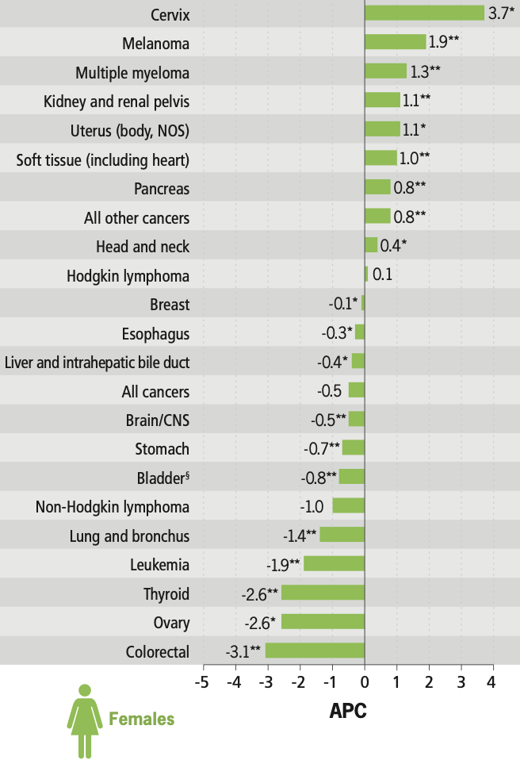

Slide 19
Why this increasing trend?
Suboptimal screening uptake
Less intensive screening
Lower coverage in younger females
Lack of follow up after screening
Changing sexual practices and prevalence of HPV
Suboptimal uptake of HPV vaccine

Slide 20
Some thoughts:
HPV test more accurate for cervix cancer detection BUT
Periodic health evaluation with examination – STI, reproductive health, clinical abnormalities, vulvar lesions?
Will we miss other opportunities regarding health detection?
Will patients know what symptoms to report?
Educate - separate cervical cancer screening from periodic health checks

Slide 23
Screening in pregnancy
Cervix screening is not necessary as a routine part of pre-natal care for those who are up to
date with cervix screening, and likely to attend for regular cervix screening. Screening can be delayed
until after pregnancy is complete.
Prenatal care can still be used as an opportunity to offer screening to those who have never been screened.
BC Cancer currently recommends that screening in the prenatal setting should be a provider-collected
so that both HPV and cytology can be assessed if needed.
The endocervical cytobrush should not be used.
Rationale:
Approximately 5% of pregnant women will have abnormal cervical cytology [73], however the incidence
of cervical cancer in pregnancy is low, ranging from 3.3 to 26 cases per 100,000 births [74] [75].

Slide 24
Canadian Task Force Recommendations: Pelvic Exam
“The CTFPHC recommends not performing a screening pelvic examination to screen for noncervical cancer, pelvic inflammatory disease, or other gynecological conditions in asymptomatic women.”
The recommendation applies to screening pelvic examination in asymptomatic, nonpregnant, adult women
Pelvic examination is appropriate in other clinical situations, such as for diagnosis of gynecological conditions when women present with symptoms or for follow up of a previously diagnosed condition
Patients with symptoms are advised to see a primary care provider, no self-screen

