Slide 1
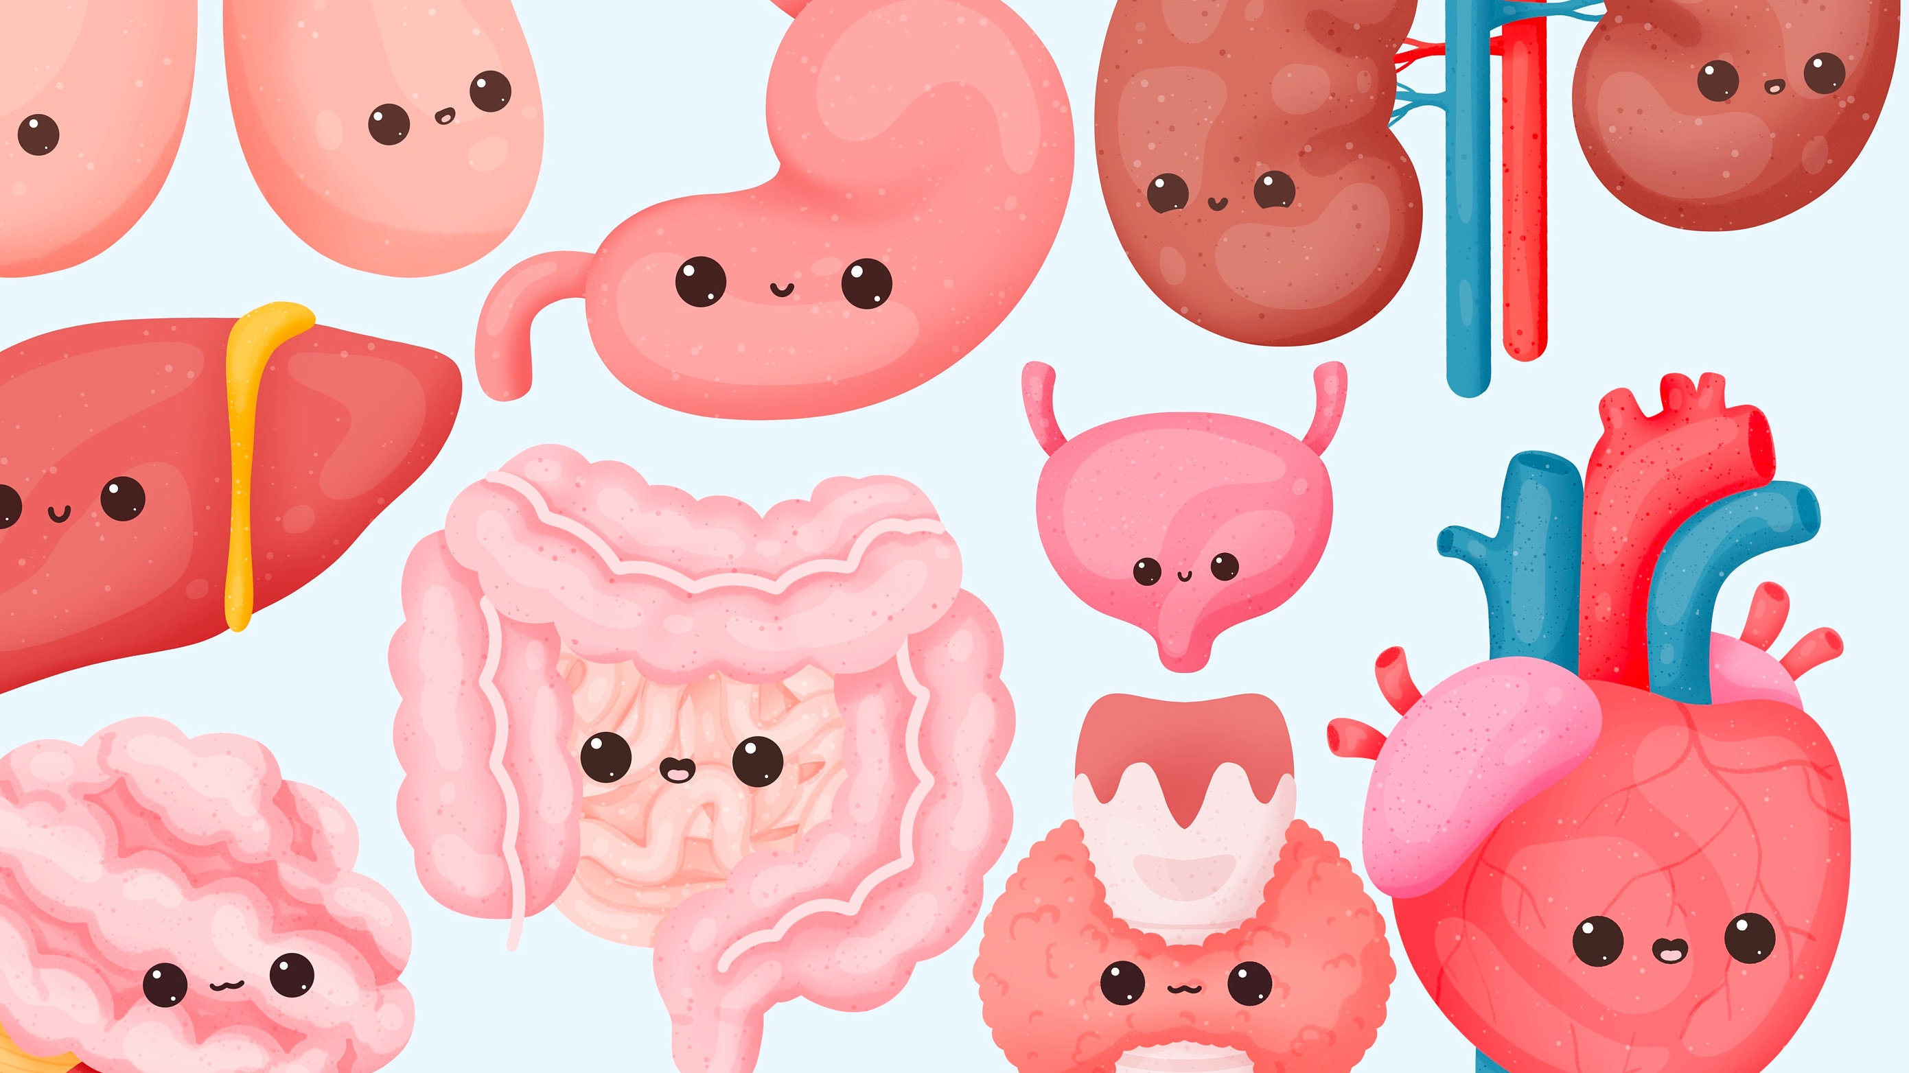

Common Pediatric Surgical Problems
General Surgery Round Table: Dine & Learn
Martina Mudri MD MSc FRCSC
Pediatric Surgeon – Victoria, BC
October 6, 2025

Slide 2
Disclosures
None

Slide 3
Topics for Review
Umbilical lesions
Abdominal wall hernias
Undescended testicles
G-tube issues

Slide 4
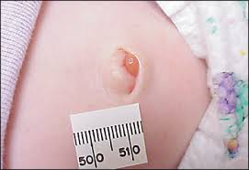
Umbilical lesions
Umbilical granuloma
Treatment
Salt
Silver nitrate application

Slide 5
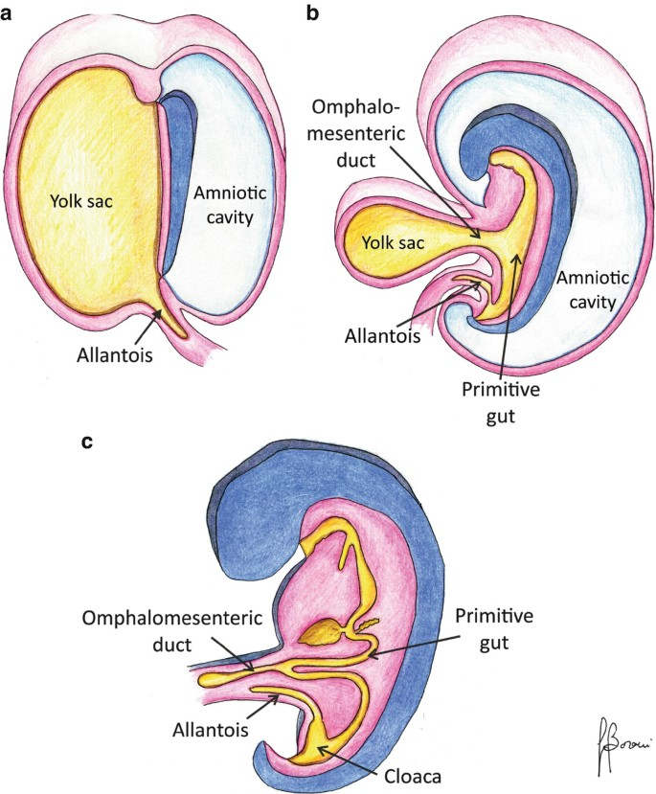
Omphalomesenteric duct and urachal remnants

Slide 6
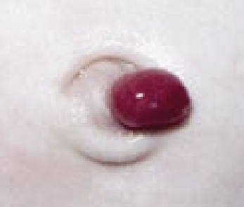
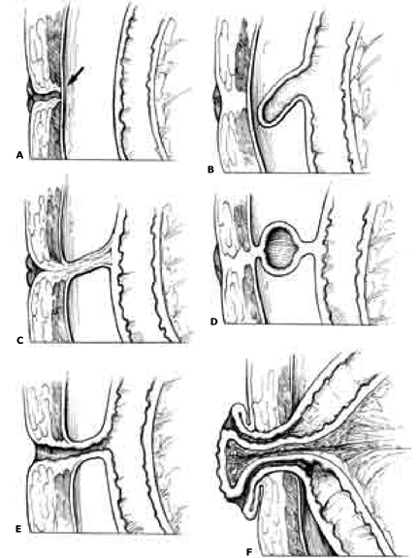
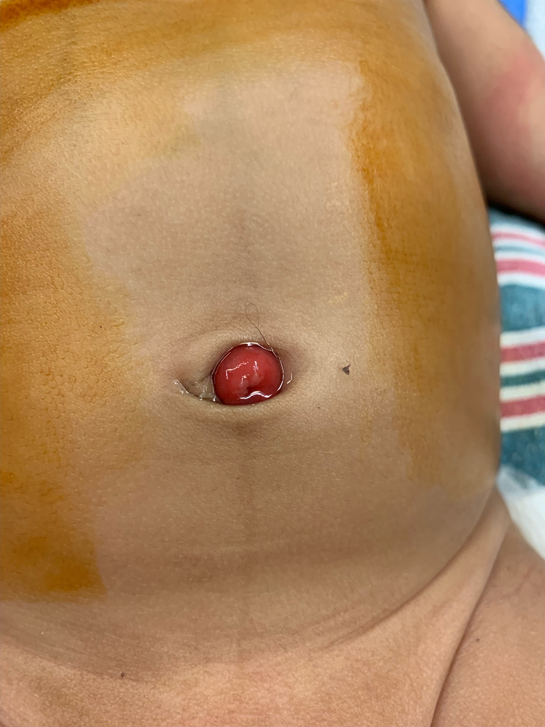
Omphalomesenteric duct remnants
Umbilical polyp
Umbilical cyst
Patent omphalomesenteric duct

Slide 7
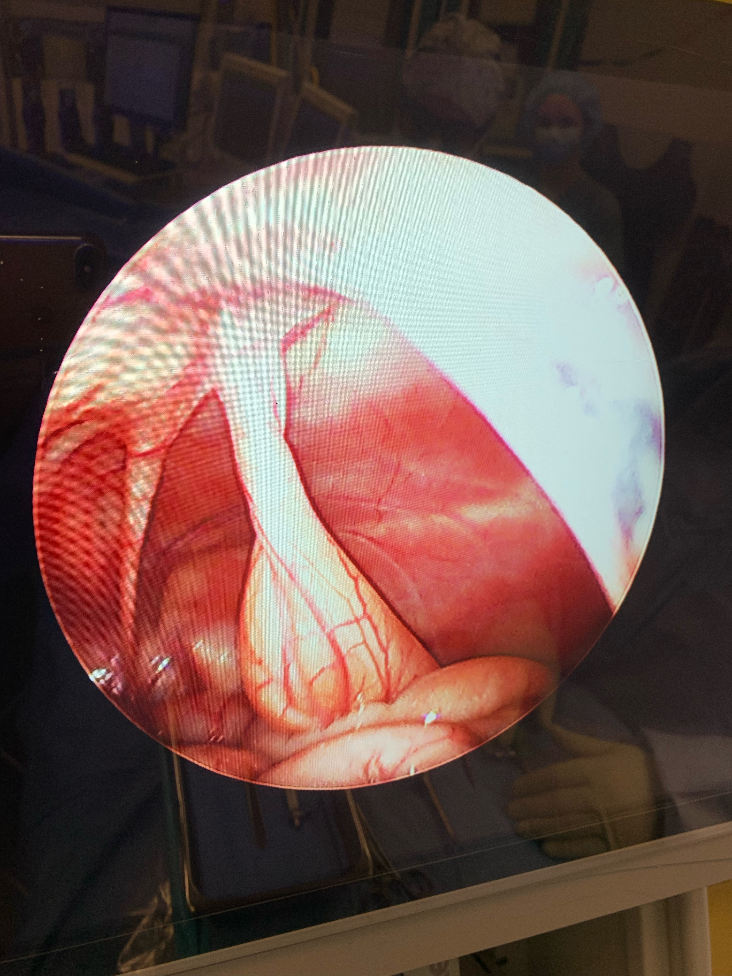
Patent omphalomesenteric duct

Slide 8
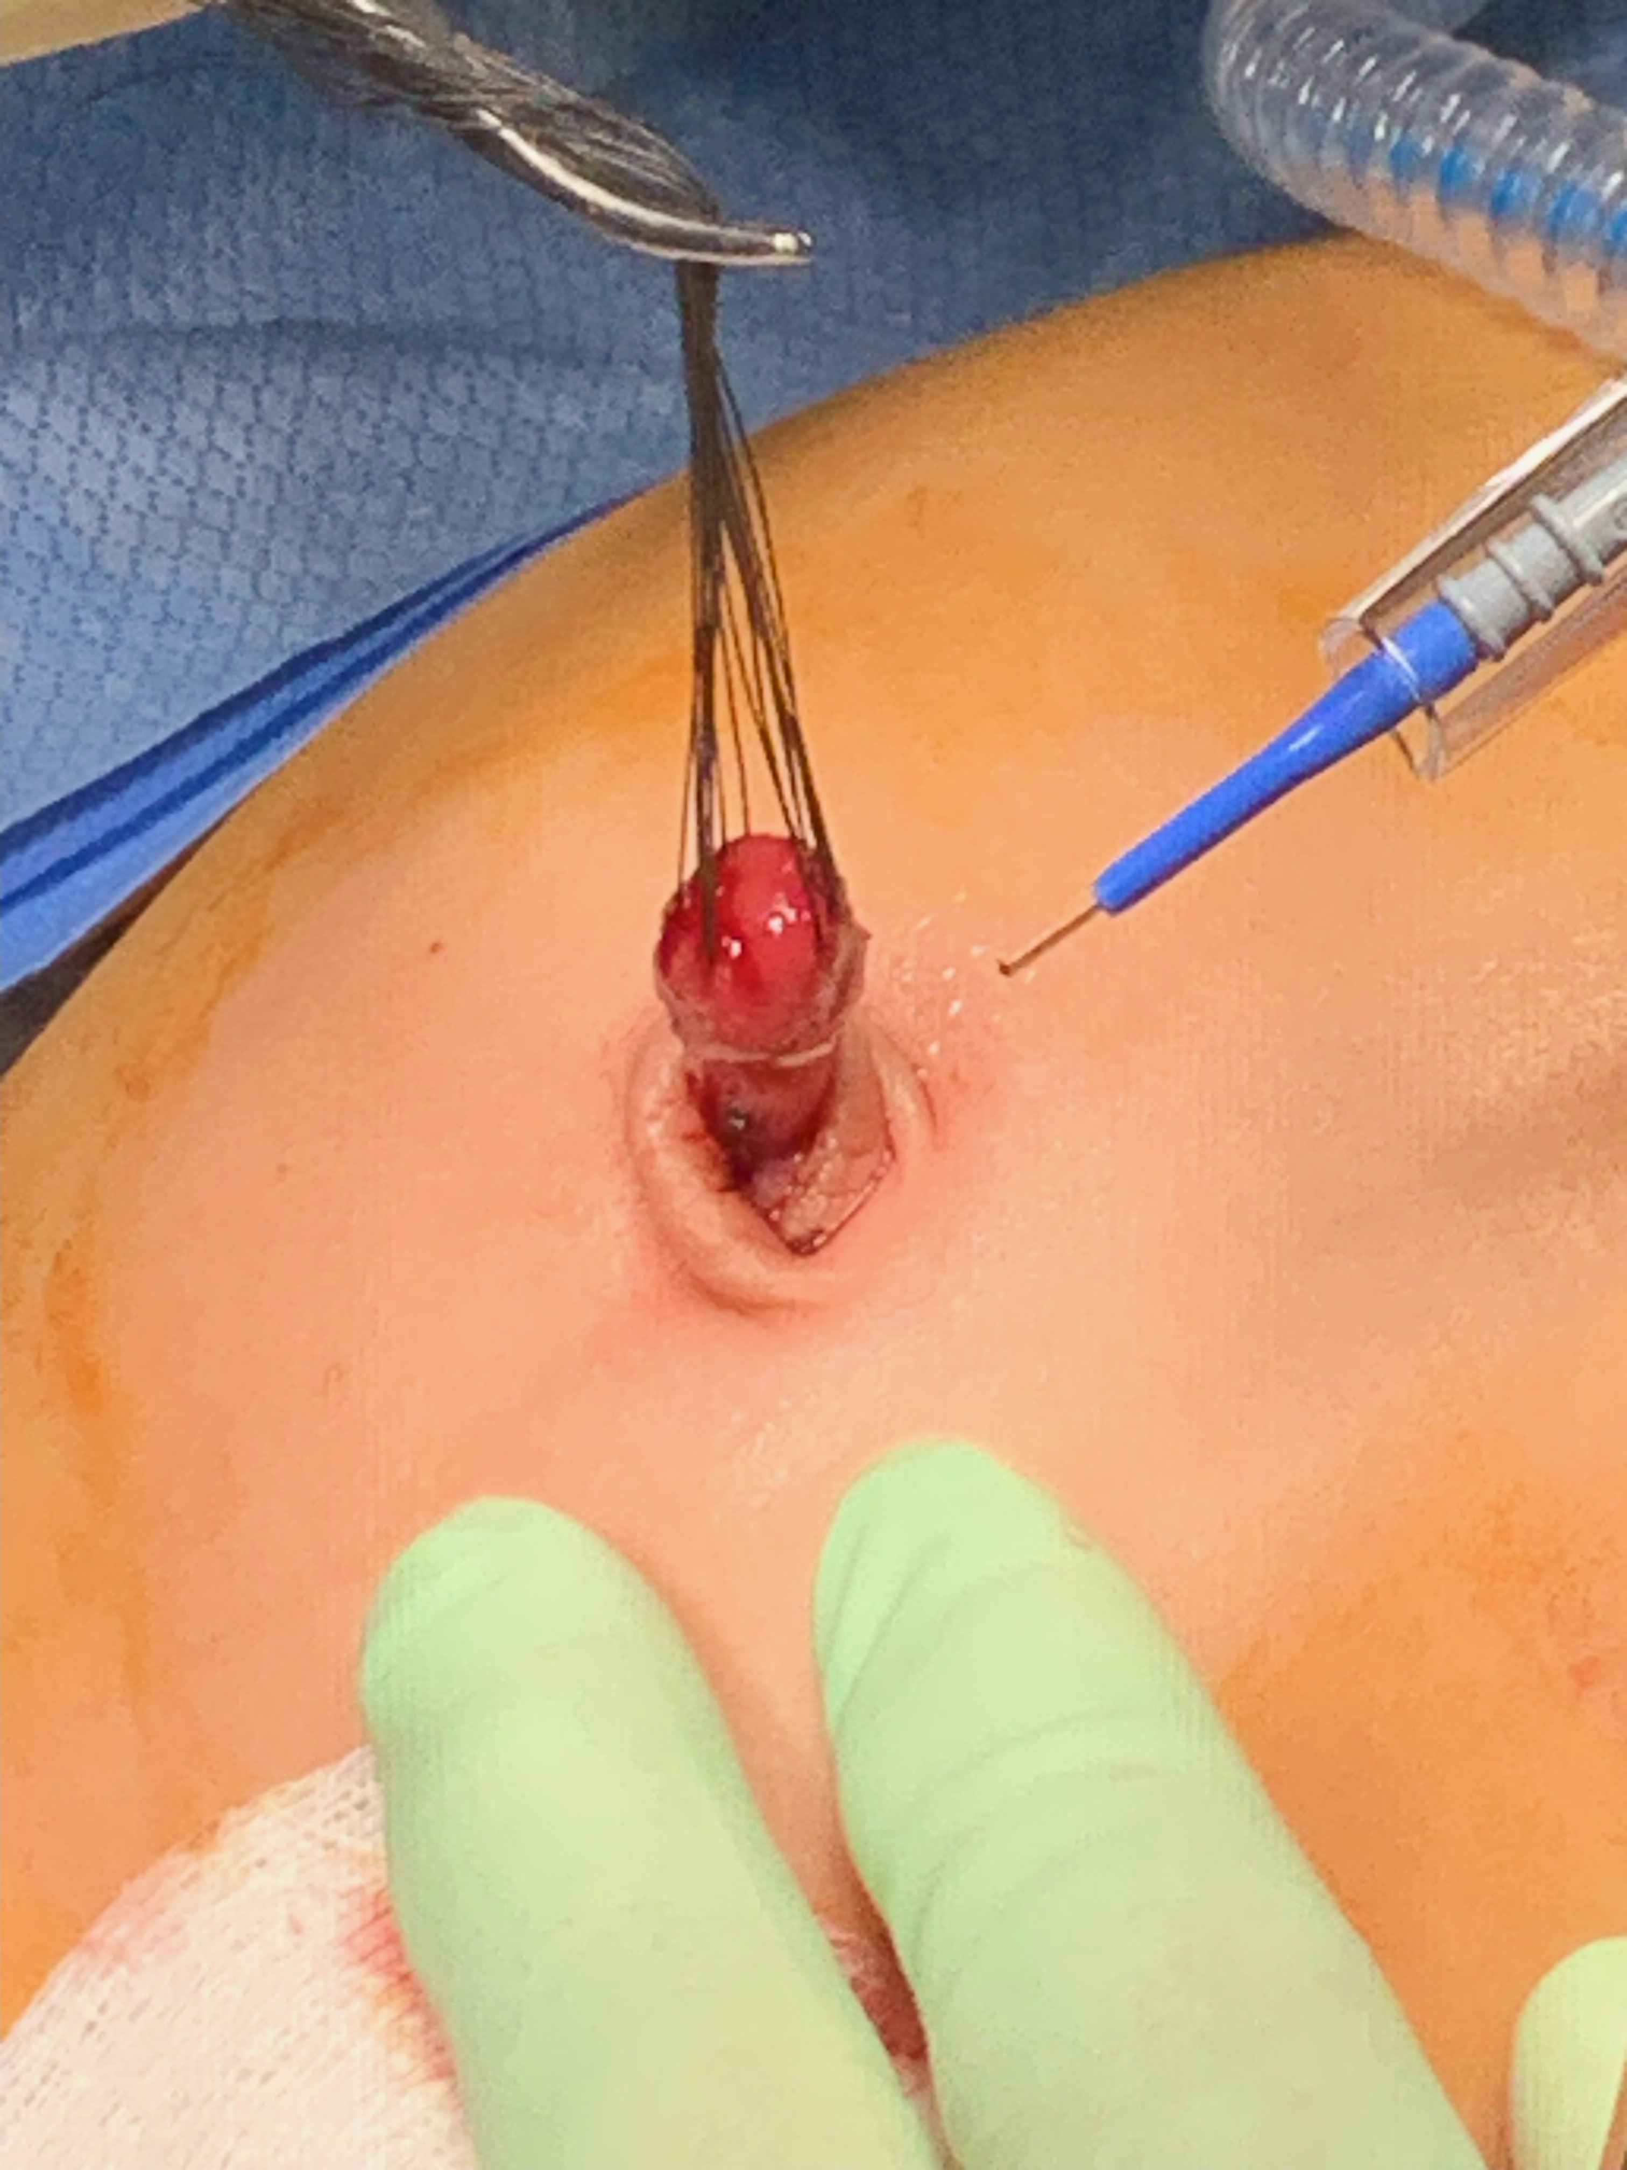
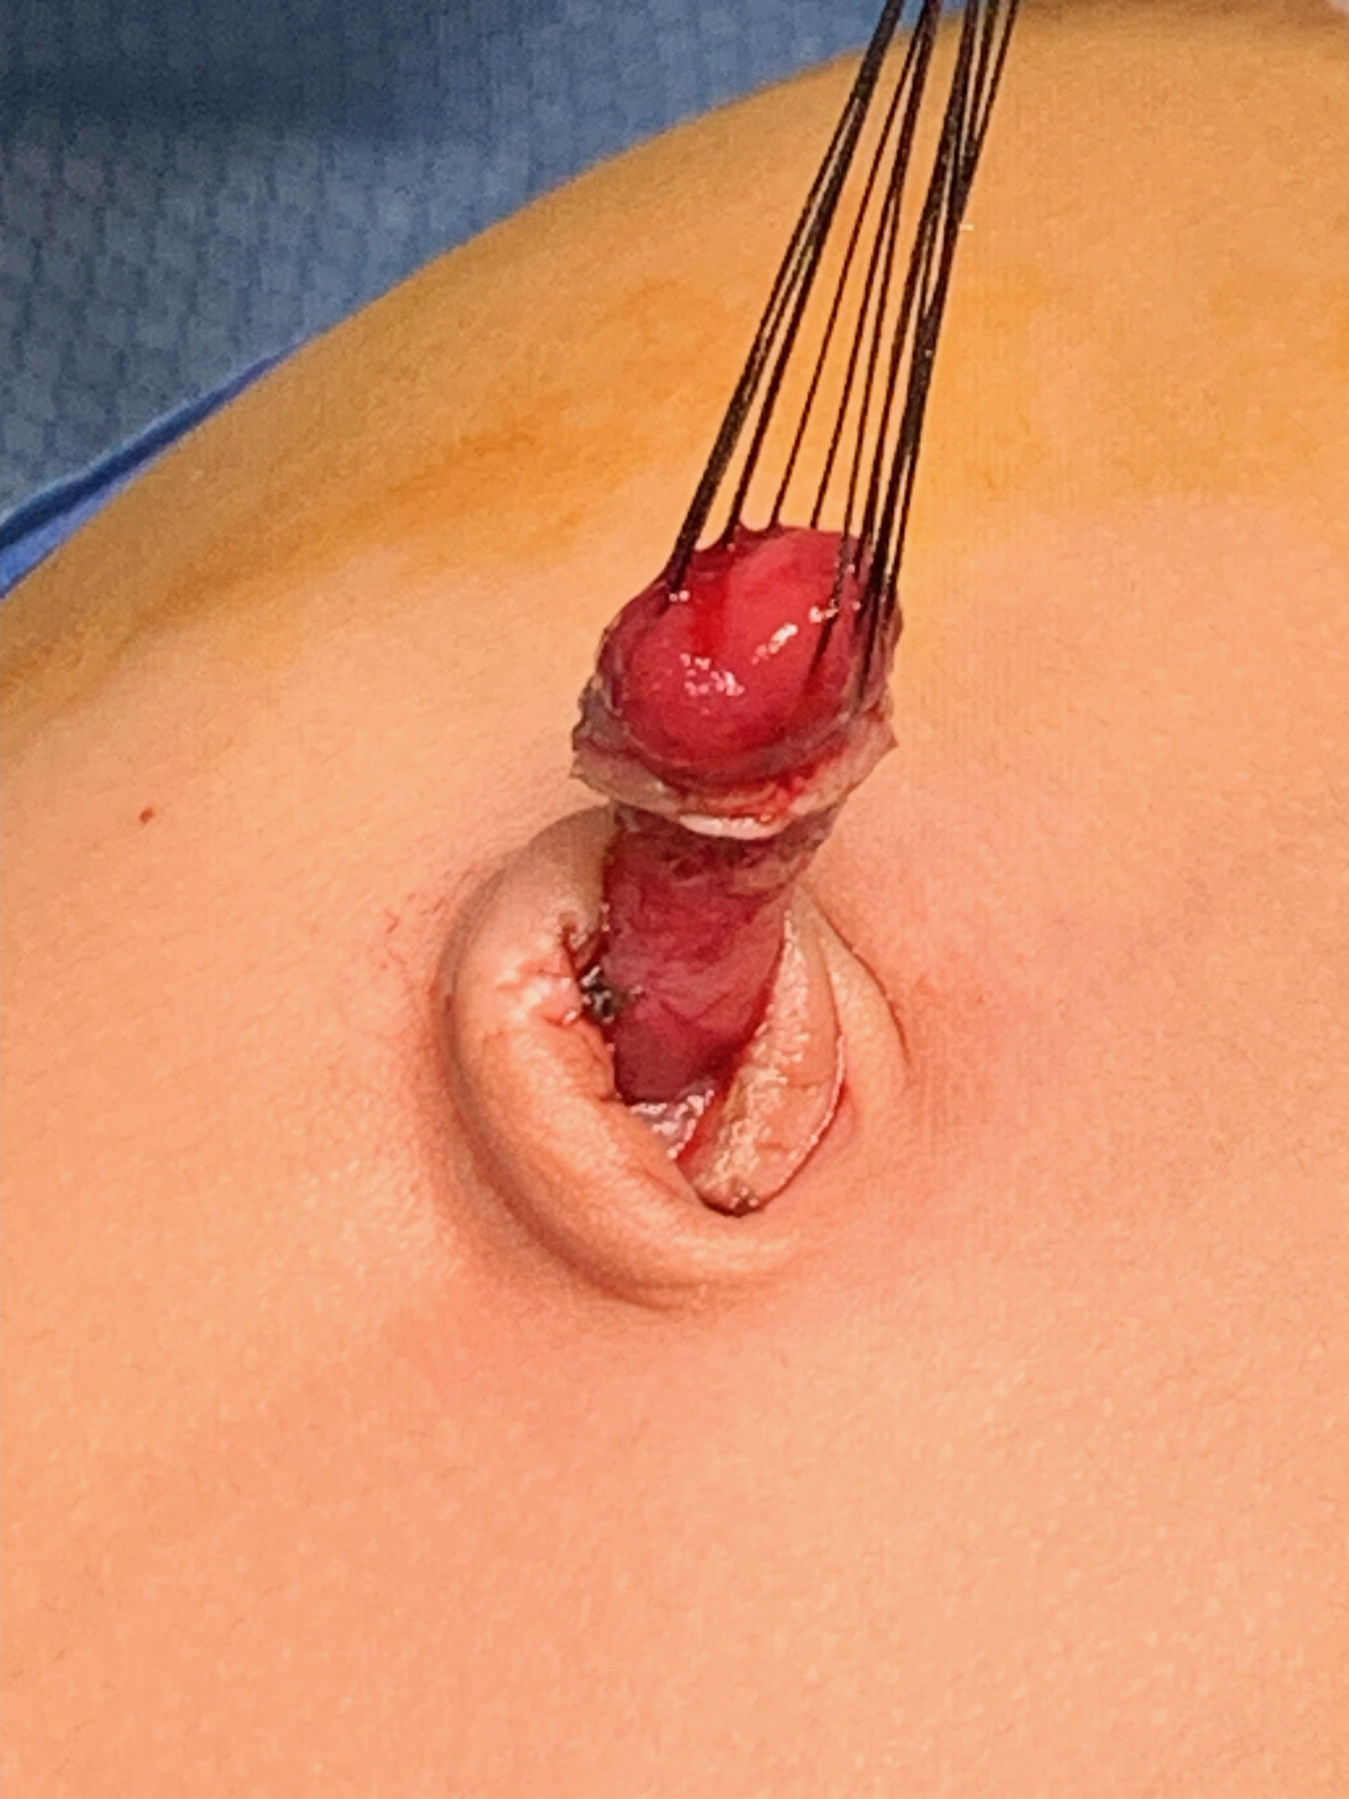

Slide 9
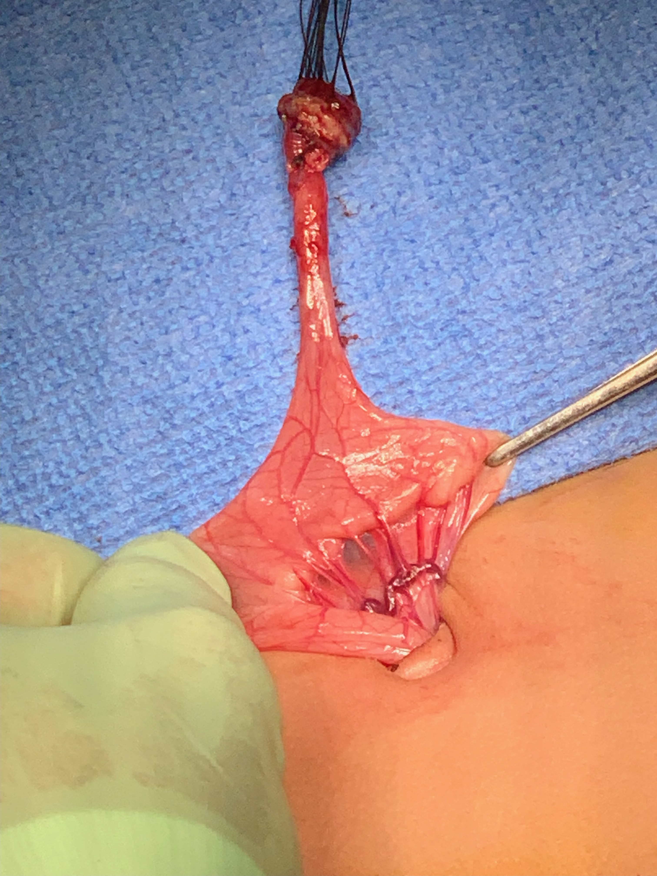
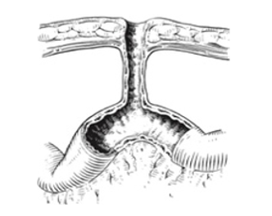

Slide 10
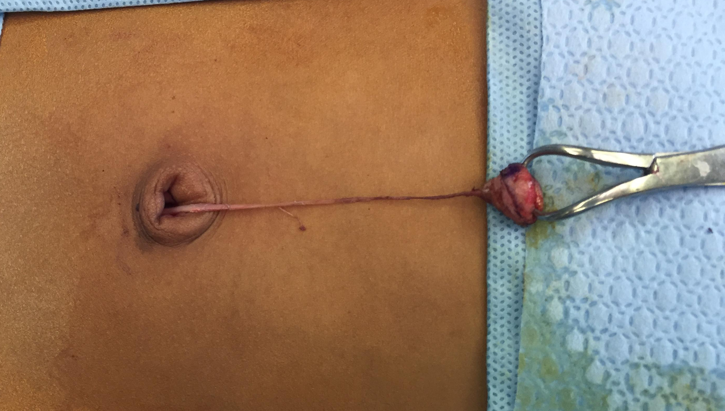
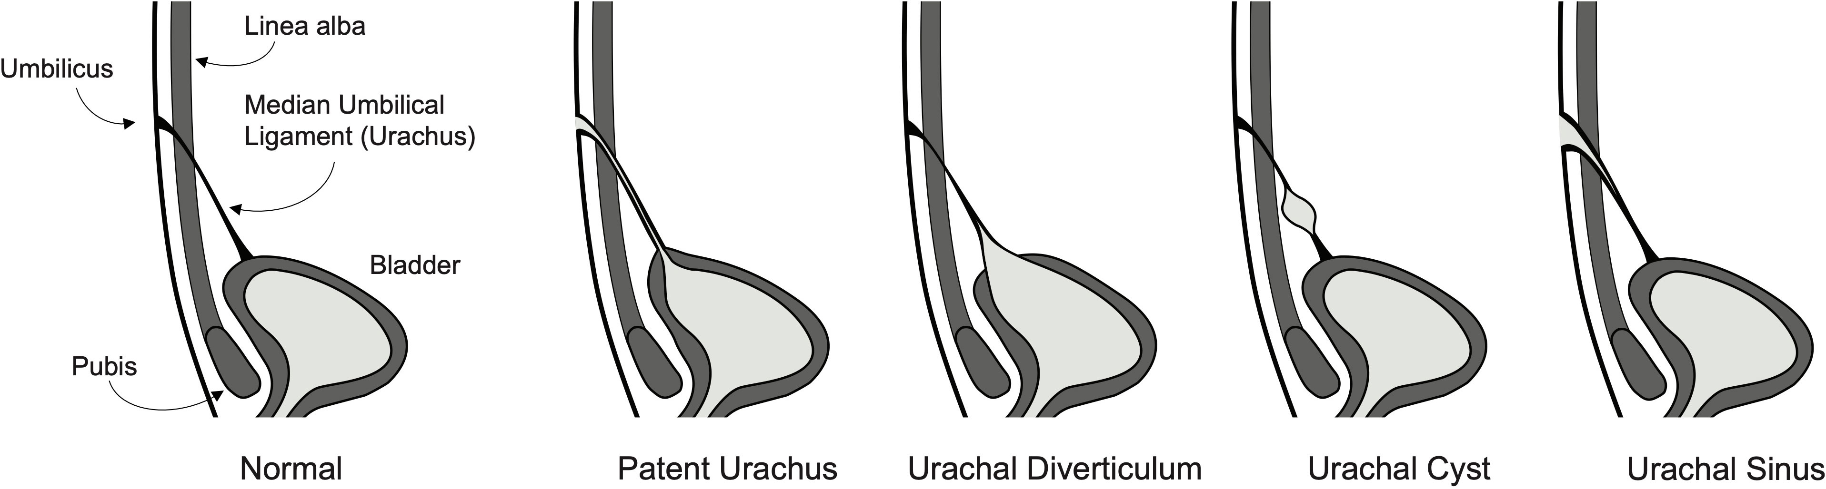
Urachal remnants
Patent urachus
Urachal sinus
Urachal cyst
Umbilical cyst attached to patent urachus
https://www.pedsurglibrary.com/apsa/view/Pediatric-Surgery-NaT/829199/all/Urachal_Remnant_Excision
https://www.frontiersin.org/journals/urology/articles/10.3389/fruro.2023.1159439/full

Slide 11
Summary
Can trial silver nitrate application if you think it is umbilical granuloma
Refer to Pediatric Surgery
Ultrasound sometimes helpful to assess for deeper tract to small bowel vs bladder – can be organized by surgeon

Slide 12
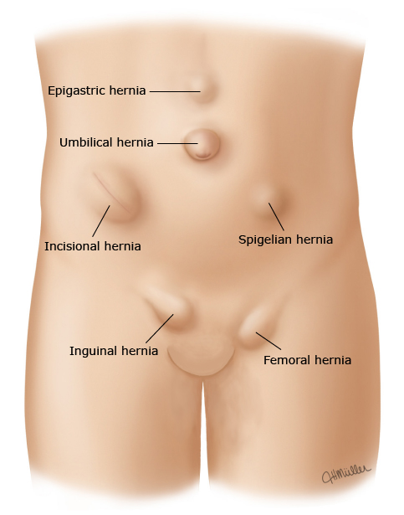
Abdominal wall hernias
Umbilical
Epigastric
Inguinal

Slide 13
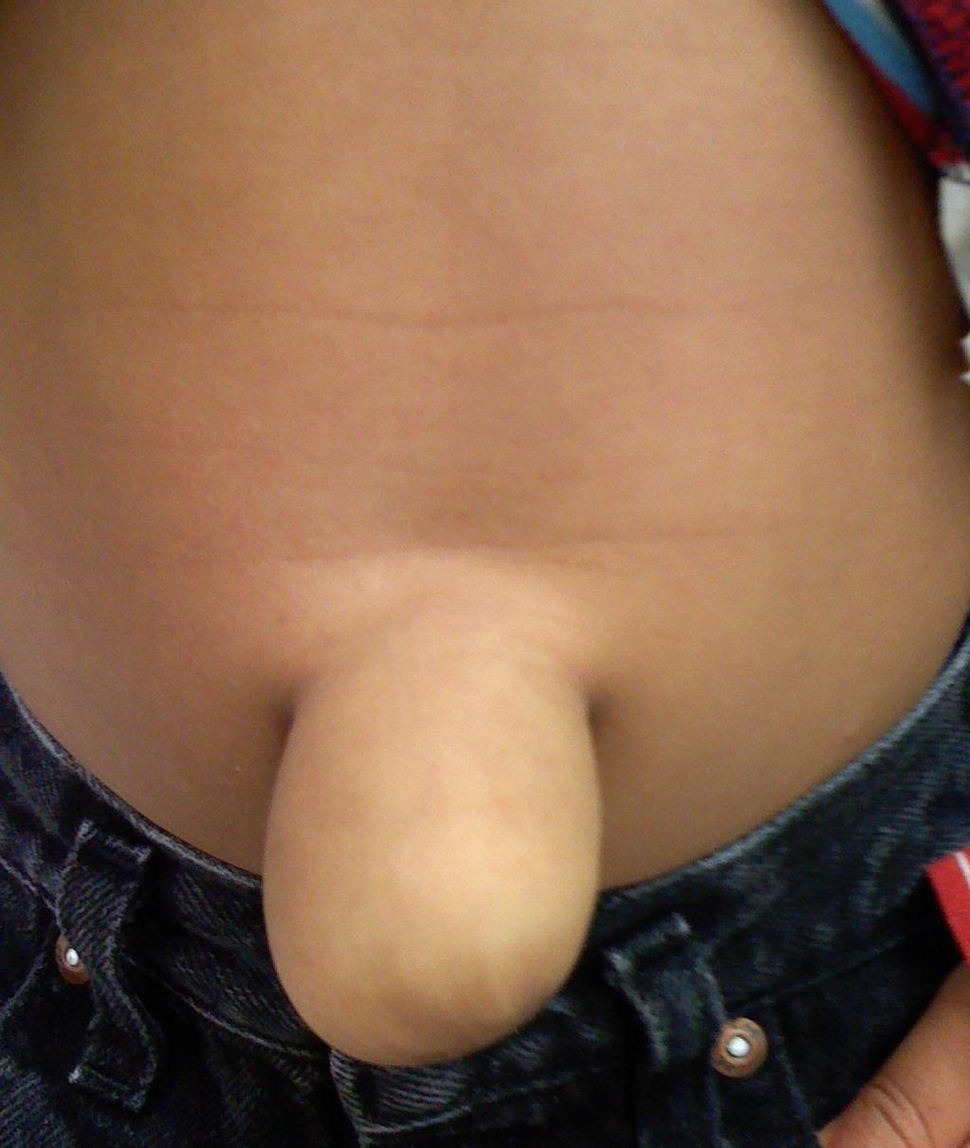
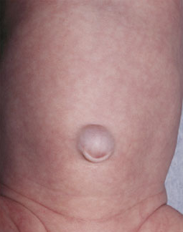
Umbilical hernia
Shastri N, Gilmer L. Periumbilical swelling in an infant. Am Fam Physician. 2008;77(8):1151-1152
Snyder CL, Soffer S. Umbilical Hernia [Internet]. In: Hirschl RR, Powell DD, Waldhausen JJ, editors. Pediatric Surgery NaT. American Pediatric Surgical Association; 2020. [cited 2024 November 05].

Slide 14
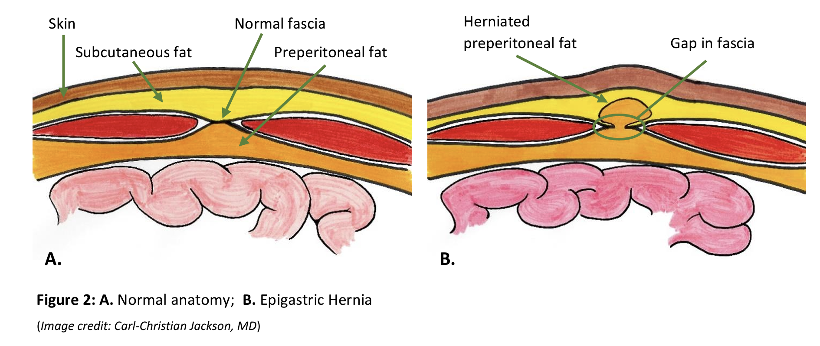
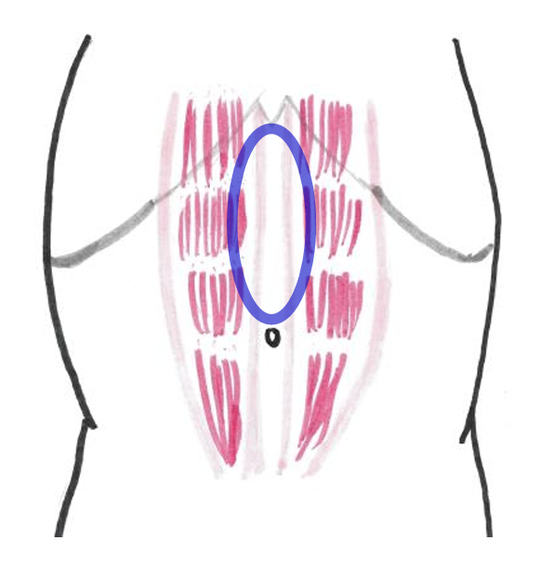
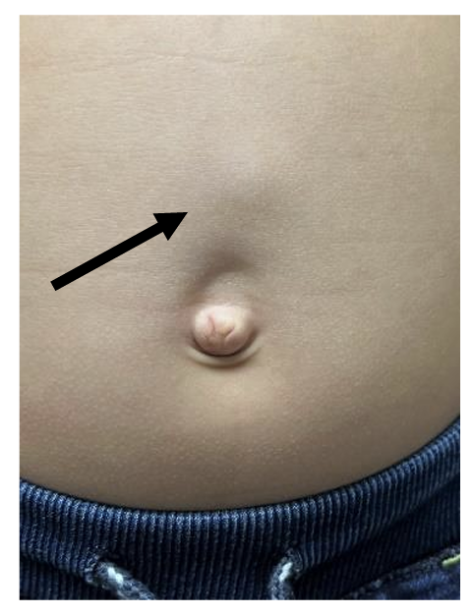
Epigastric hernia
Image credit: Carl-Christian Jackson, MD
Jackson CC. Editors Hollinger LE, Taylor JA. Epigastric Hernia. Patient and family information, brought to you by the Education Committee of APSA. 2023 September

Slide 15
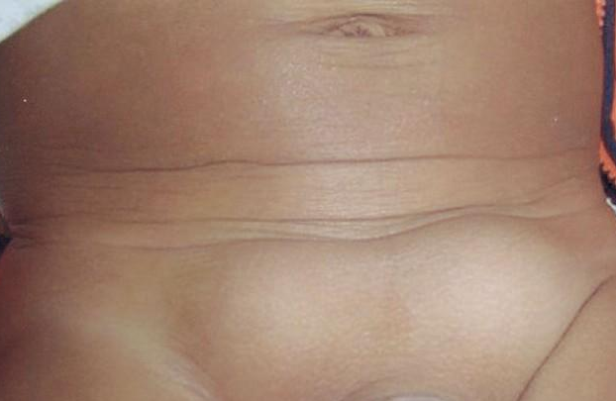
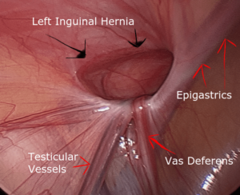
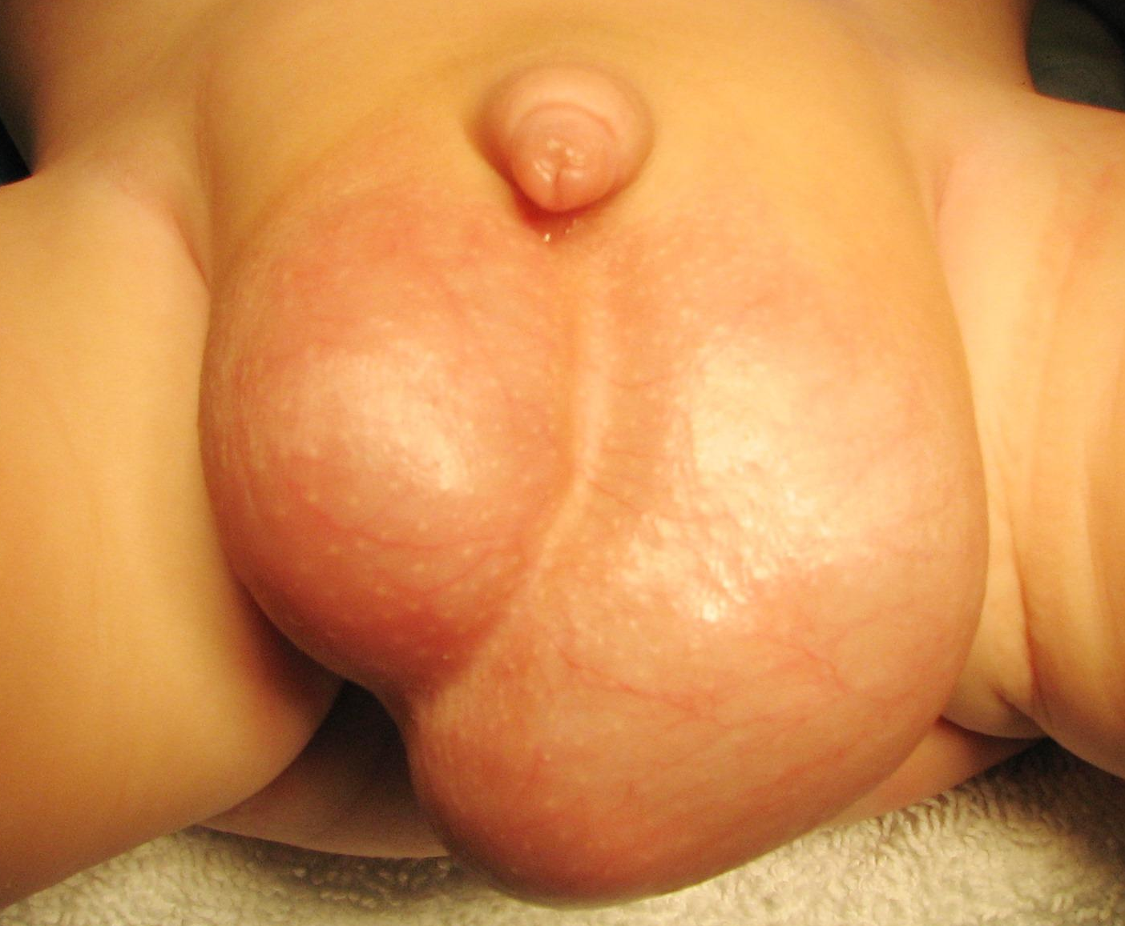
Inguinal hernia
Emil S. Abdominal Wall Hernias. Clinical Pediatric Surgery.Taylor & Francis; 2019.
Inguinal Hernia [Internet]. In: Hirschl RR, Powell DD, Waldhausen JJ, editors. Pediatric Surgery NaT. American Pediatric Surgical Association; 2020. [cited 2024 November 05]. Available from: https://www.pedsurglibrary.com/apsa/view/Pediatric-Surgery-NaT/829066/all/Inguinal_Hernia.

Slide 16

Risk of incarceration
The majority of incarcerations occur within the first year of life
50% occur within the first 6 months of life
Incidence previously thought to be up to 30%
4% in late repair group
(>55 weeks PMA)
vs
1% in early repair group
(prior to NICU discharge)
Blakely ML, Krzyzaniak A, Dassinger MS, Pedroza C, Weitkamp JH, Gosain A, Cotten M, Hintz SR, Rice H, Courtney SE, Lally KP. Effect of early vs late inguinal hernia repair on serious adverse event rates in preterm infants: a randomized clinical trial. JAMA. 2024 Mar 26;331(12):1035-44.
Inguinal Hernia [Internet]. In: Hirschl RR, Powell DD, Waldhausen JJ, editors. Pediatric Surgery NaT. American Pediatric Surgical Association; 2020. [cited 2024 November 05]. Available from: https://www.pedsurglibrary.com/apsa/view/Pediatric-Surgery-NaT/829066/all/Inguinal_Hernia.

Slide 17
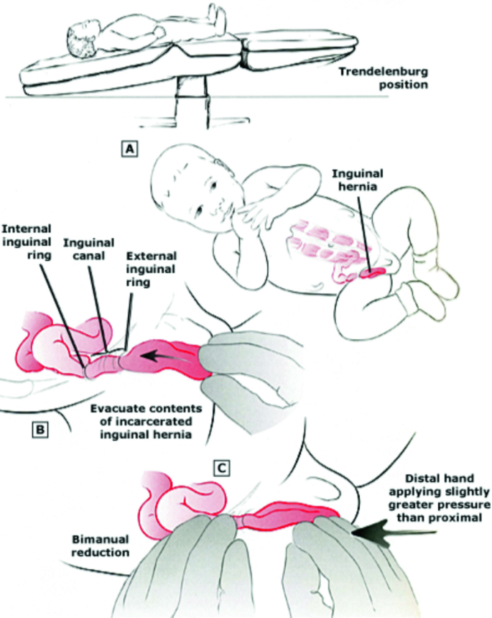

Manual reduction of incarcerated inguinal hernia
Quirt JS, Fecteau A. Hernias—Epigastric, Inguinal and Incisional. Pearls and Tricks in Pediatric Surgery. 2021:113-23.

Slide 18
Summary
Hernia Type | Recommendations
Umbilical | Referral at school age (4-5 years old)
Epigastric | Referral at diagnosis
Inguinal | Referral at diagnosis
Routine ultrasound not recommended*
Emil S. Abdominal Wall Hernias. Clinical Pediatric Surgery.Taylor & Francis; 2019.
Hall DE, Roberts KB, Charney E. Umbilical hernia: what happens after age 5 years? J Pediatr. 1981;98(3):415-7.
Inguinal Hernia [Internet]. In: Hirschl RR, Powell DD, Waldhausen JJ, editors. Pediatric Surgery NaT. American Pediatric Surgical Association; 2020.
Snyder CL, Soffer S. Umbilical Hernia [Internet]. In: Hirschl RR, Powell DD, Waldhausen JJ, editors. Pediatric Surgery NaT. American Pediatric Surgical Association; 2020.

Slide 19
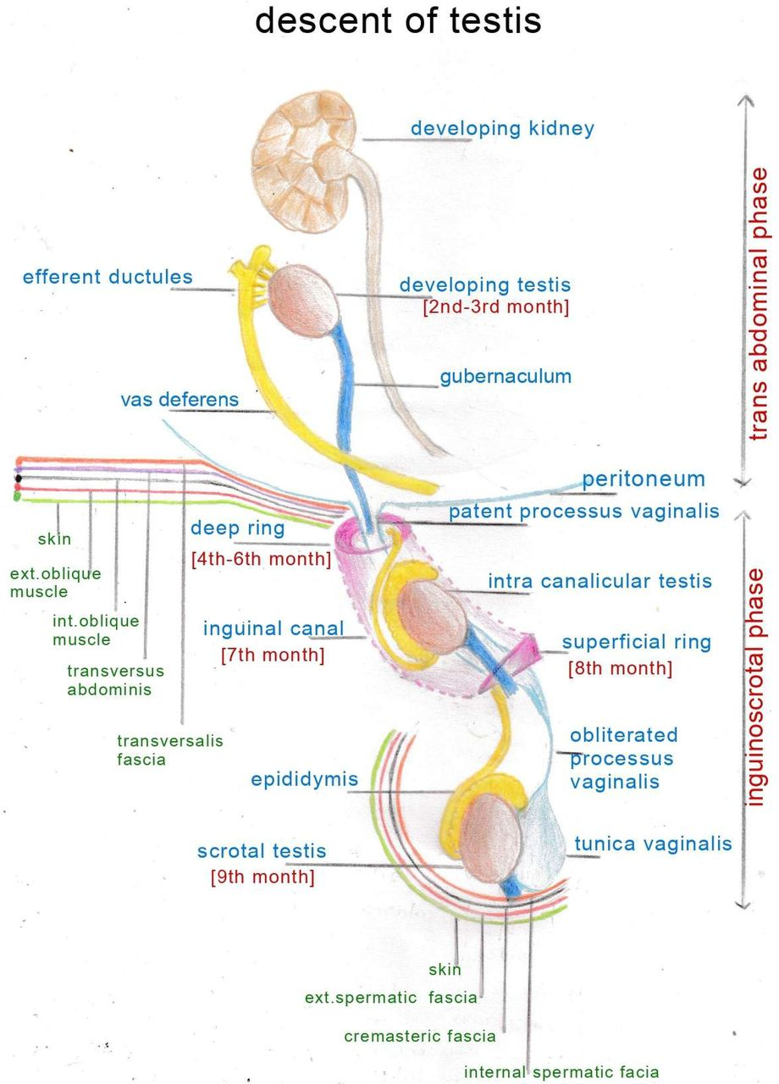
Undescended Testicles

Slide 20
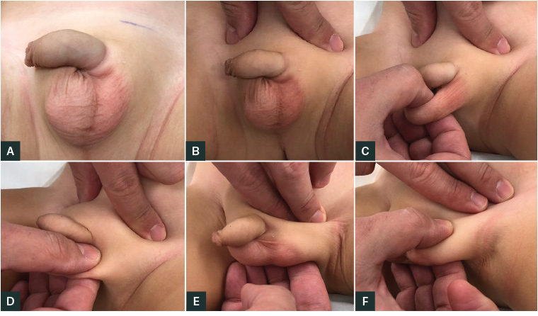
Physical Exam
 | Definition | Management
Undescended testis | Testis undescended at birth | Orchidopexy
Ascending testis | Testis descended at birth with subsequent ascent | Orchidopexy
Retractile testis | Normal variant; intermittently within scrotum | Annual clinical surveillance until puberty
Yeap E, Nataraja RM, Pacilli M. Undescended testes: What general practitioners need to know. Australian Journal of General Practice. 2019 Jan;48(1/2):33-6.
Taghavi K, Chin A, Radhakrishnan J. Cryptorchidism [Internet]. In: Hirschl RR, Powell DD, Waldhausen JJ, editors. Pediatric Surgery NaT. American Pediatric Surgical Association; 2022.

Slide 21
Guidelines
Group | Recommended age for orchidopexy
AUA (2014) | Between 6 and 18 months of age
EAU (2021) | Between 6 and 18 months of age; Ideally by 12 months of age
CUA (2017) | Between 6 and 18 months of age
BAPS (2015) | Between 6 and 18 months of age
APSA (2022) | Between 6 and 12 months of age
Gates RL, Shelton J, Diefenbach KA, Arnold M, Peter SD, Renaud EJ, Slidell MB, Sømme S, Valusek P, Villalona GA, McAteer JP. Management of the undescended testis in children: an American pediatric surgical association outcomes and evidence based practice committee systematic review. Journal of pediatric surgery. 2022 Jul 1;57(7):1293-308
Taghavi K, Chin A, Radhakrishnan J. Cryptorchidism [Internet]. In: Hirschl RR, Powell DD, Waldhausen JJ, editors. Pediatric Surgery NaT. American Pediatric Surgical Association; 2022. Available from: https://www.pedsurglibrary.com/apsa/view/Pediatric-Surgery-NaT/829144/all/Cryptorchidism.
Notes:
.

Slide 22
Summary
Main reasons for orchidopexy are to maintain fertility and decrease malignancy risk
For every 6 months’ delay in orchidopexy beyond 18 months, there is a 6% increase in risk of testicular cancer (Schneuer et al 2018)
Most guidelines recommend that orchidopexy be performed between 6 – 18 months of age, ideally by 12 months of age
Refer patients if testicle(s) have not descended by 6 months of age
Gates RL, Shelton J, Diefenbach KA, Arnold M, Peter SD, Renaud EJ, Slidell MB, Sømme S, Valusek P, Villalona GA, McAteer JP. Management of the undescended testis in children: an American pediatric surgical association outcomes and evidence based practice committee systematic review. Journal of pediatric surgery. 2022 Jul 1;57(7):1293-308
Taghavi K, Chin A, Radhakrishnan J. Cryptorchidism [Internet]. In: Hirschl RR, Powell DD, Waldhausen JJ, editors. Pediatric Surgery NaT. American Pediatric Surgical Association; 2022.

Slide 23
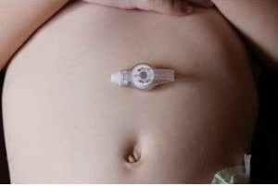
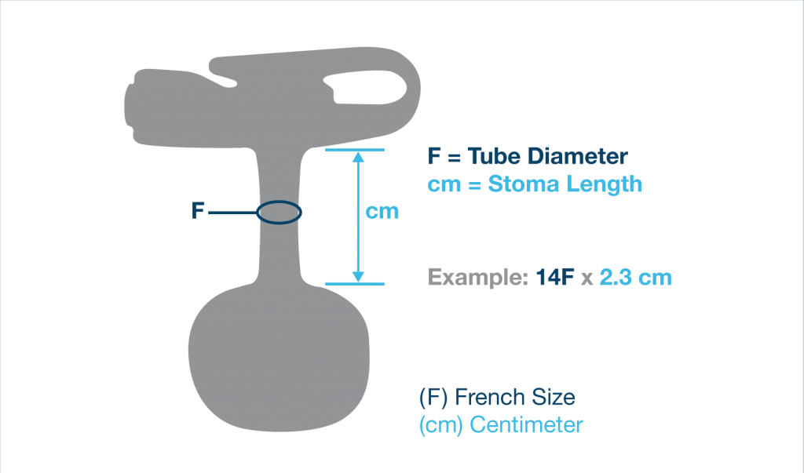
Gastrostomy tube issues
https://capitalmedicalsupply.ca/products/1-mic-key-low-profile-gastrostomy-feeding-tube

Slide 24
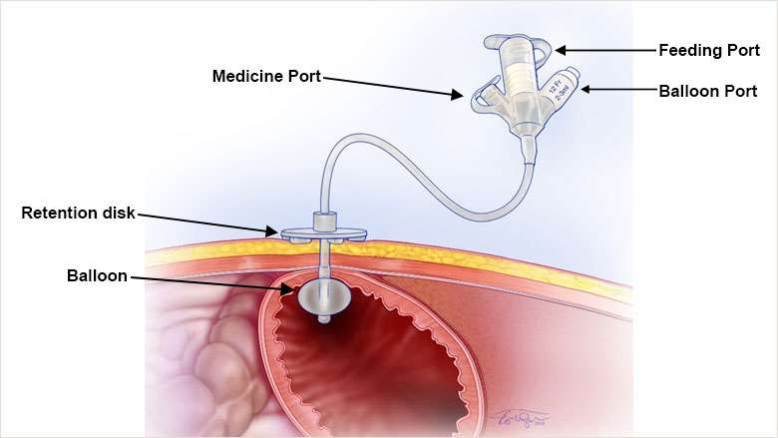
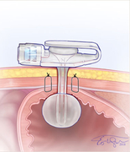
Long tubes & low-profile tubes
https://www.chop.edu/treatments/gastrostomy-tubes

Slide 25
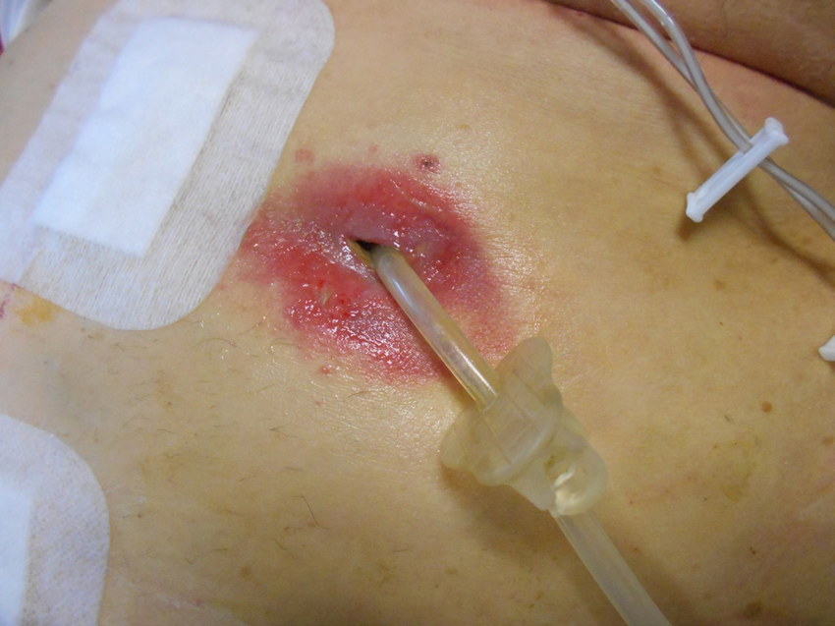
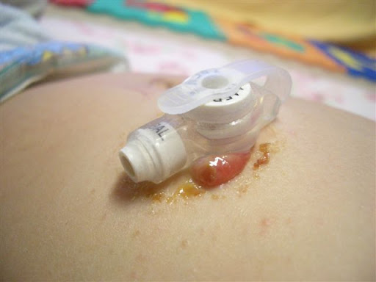
Leakage
Hypergranulation tissue
Boeykens K, Duysburgh I, Verlinden W. Prevention and management of minor complications in percutaneous endoscopic gastrostomy. BMJ Open Gastroenterology. 2022 Jul 1;9(1):e000975
http://www.bcchildrens.ca/health-info/coping-support/tube-feeding

Slide 26
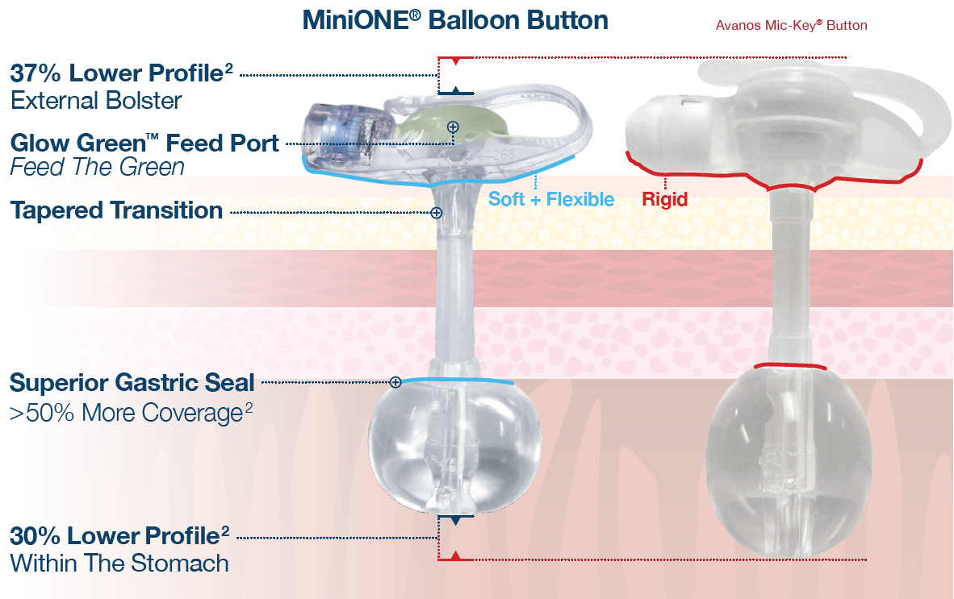
Troubleshooting G-tube issues
For an established gastrostomy (i.e. >4-6 weeks after surgery)
Check the balloon
Is the length/fit appropriate?
Too long/loose vs too short/tight
Treatments
Peristomal skin care and dressings
Salt, steroid cream (Triamcinolone) , or silver nitrate for hypergranulation tissue
Try different style of g-tube
Jarboe MD, Speck K, Demehri F, Alder AC, Black T, Guner Y. Enteral Access [Internet]. In: Hirschl RR, Powell DD, Waldhausen JJ, editors. Pediatric Surgery NaT. American Pediatric Surgical Association; 2022. [cited 2024 November 05]. Available from: https://www.pedsurglibrary.com/apsa/view/Pediatric-Surgery-NaT/829032/all/Enteral_Access.
Pediatric Home Tube Feeding. Island Health. Revised 06-Jun-2024. https://intranet.islandhealth.ca/clinical_resources/patient_education/Documents/pediatric-home-tube-feeding.pdf.

Slide 27
SUMMARY
Umbilical Lesions
Trial silver nitrate application if umbilical granuloma
Refer to Pediatric Surgery
Abdominal Wall Hernias
Umbilical – refer around school age (4-5 years)
Epigastric – refer at diagnosis
Inguinal – refer at diagnosis
Undescended Testicles
Orchidopexy performed to maintain fertility and decrease malignancy risk
For every 6 months’ delay in orchidopexy beyond 18 months, there is a 6% increase in risk of testicular cancer (Schneuer et al 2018)
Most guidelines recommend orchidopexy between 6 – 18 months of age, ideally by 12 months of age
Refer patients if testicle(s) have not descended by 6 months of age
Troubleshooting g-tubes
Check the balloon
Is the length/fit appropriate?
Treatments
Peristomal skin care and dressings
Salt, steroid cream (Triamcinolone) , or silver nitrate for hypergranulation tissue
Try different style of g-tube
miniONE vs MIC-KEY

